Slide 1

Jean Coleman & Brid Quinn

Slide 2
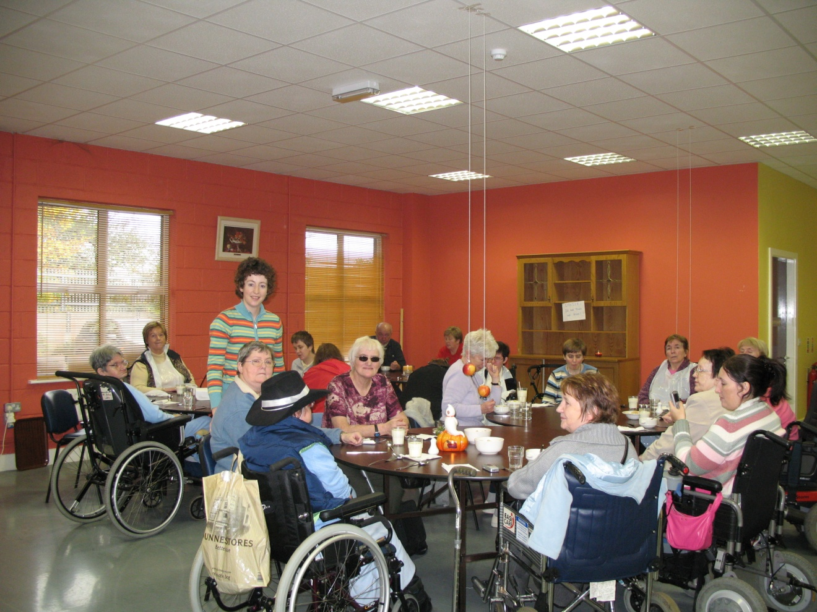
OUR SERVICES ARE FOR AND ABOUT PEOPLE

Slide 3
IWA MISSION STATEMENT
The Irish Wheelchair Association is a national organisation dedicated to the achievement of full social, economic and educational integration of people with disabilities as equal, independent and participative members of the general community.

Slide 4
PERSON CENTRED APPROACH
Person Centred Approach underpins what we do and is central to the Ethos of the IWA
Notes:
Very brief reminder that this is is the principle we work from. Mention here that “person” could also be a staff member as well as a service user

Slide 5
SERVICES
Resource Centres
Assisted Living Services
Transport
Motoring
Training

Slide 6
CENTRES
CUISLE – 090 6662277
SLIGO – 071 9155522
MANORCUNNINGHAM – 074 9157393
CARRICK ON SHANNON – 071 9620569

Slide 7



Cuisle Holiday Centre
Accessible and Supported
Holidays and Breaks

Slide 8
Supports Available:
    Personal assistance
    Nursing care
    Portable hoists
    Personal call bells

Slide 9
Facilities:

Slide 10
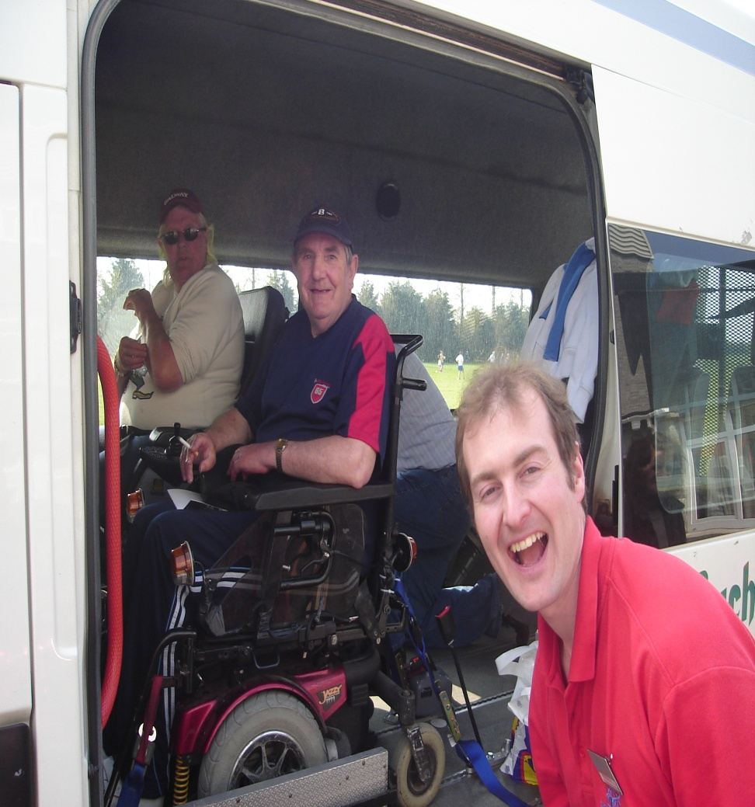
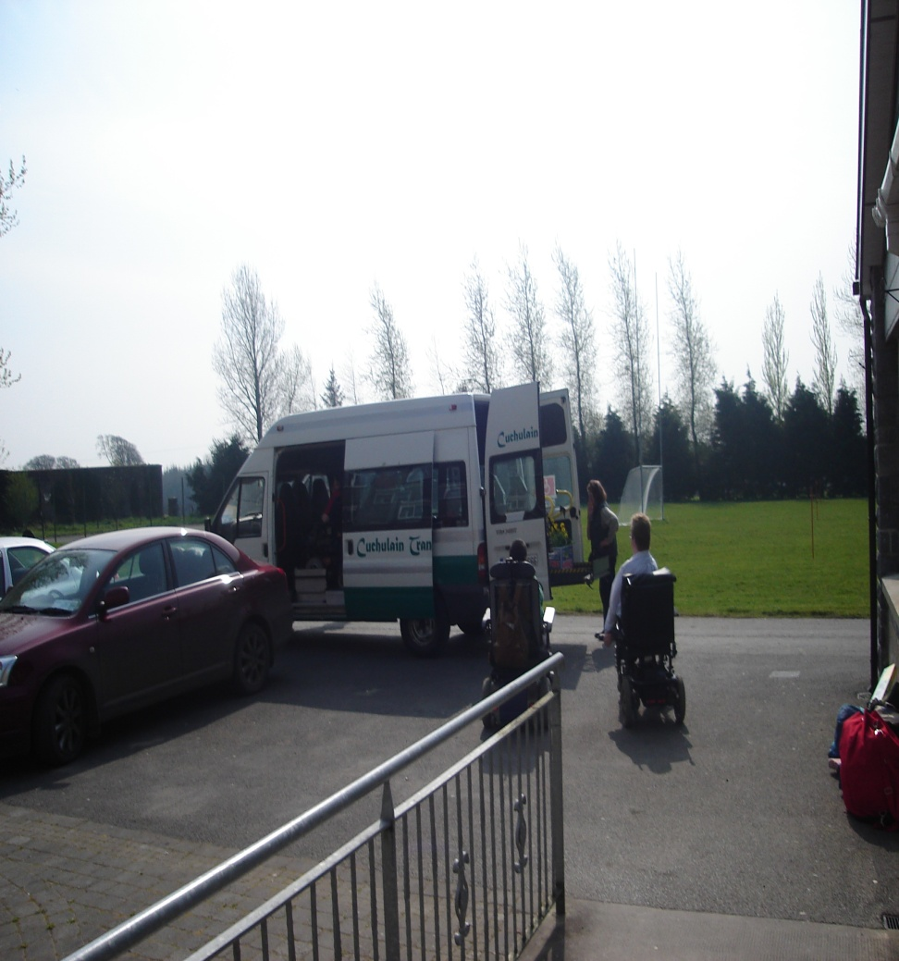
Accessible transport

Slide 11
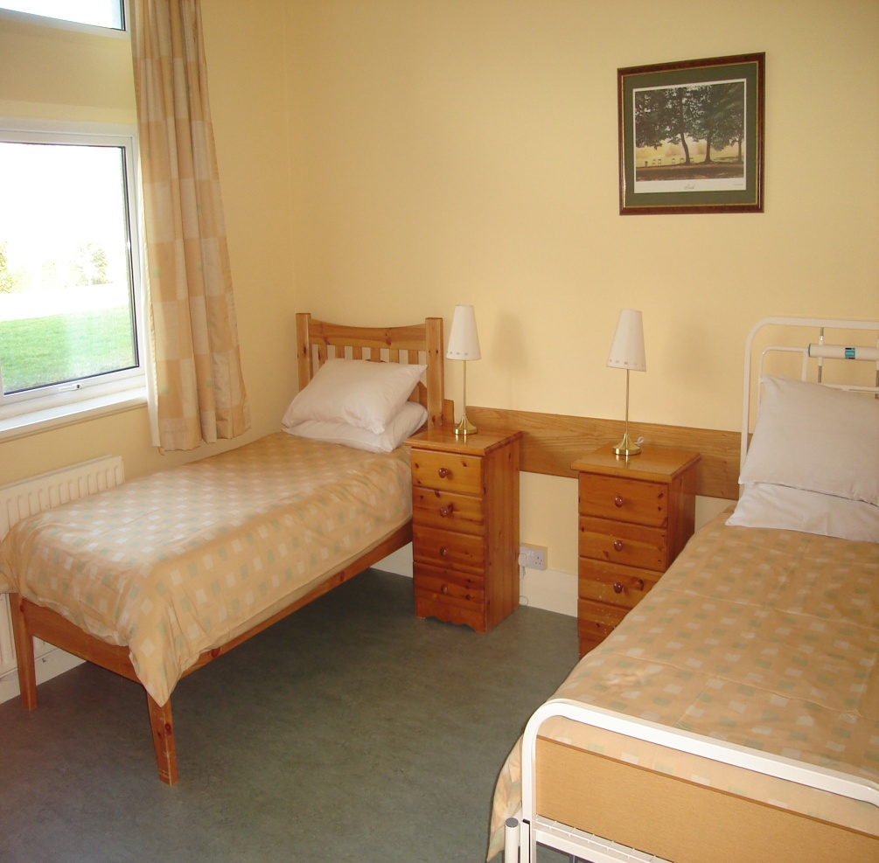
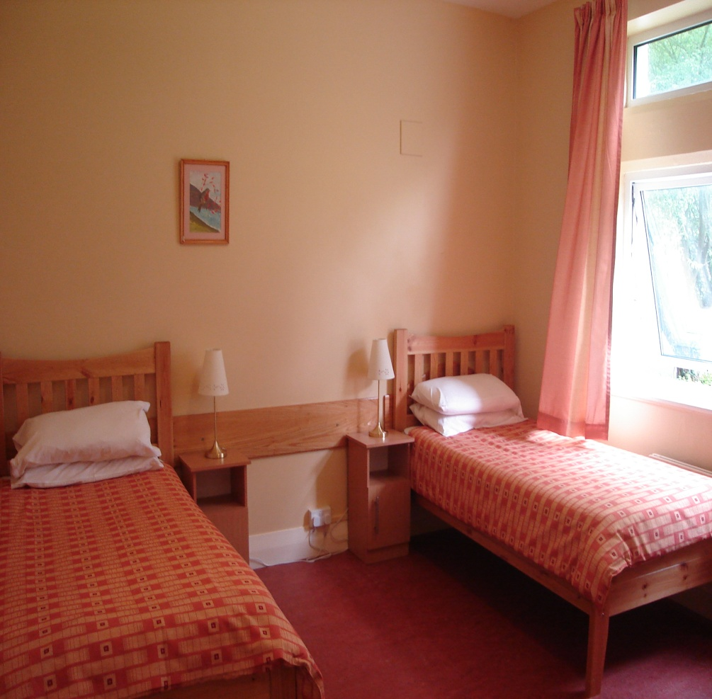
34 en-suite bedrooms with TV

Slide 12
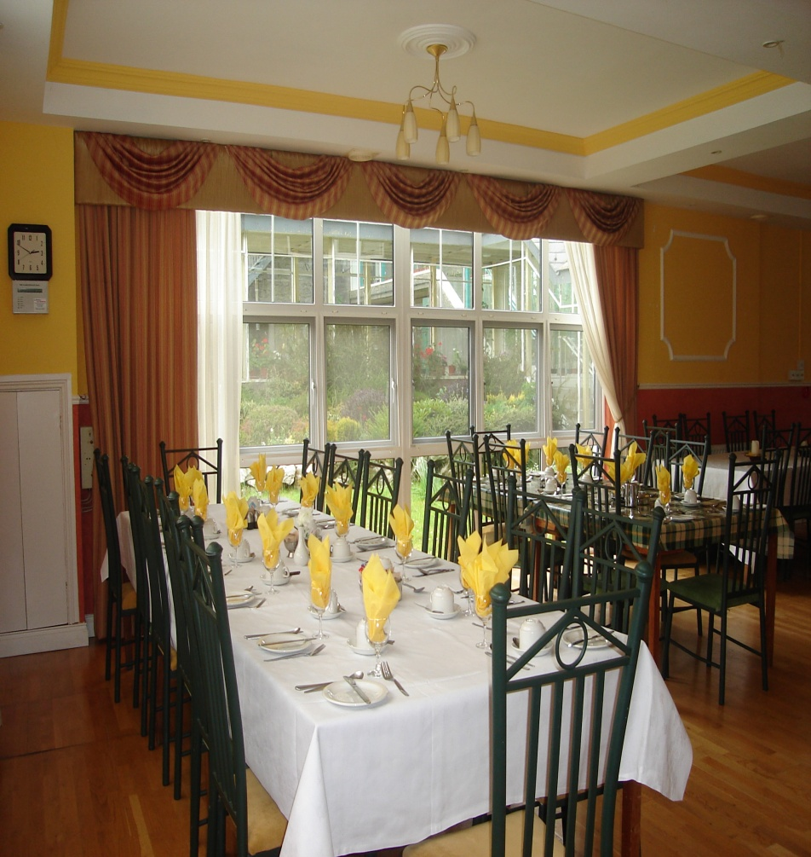
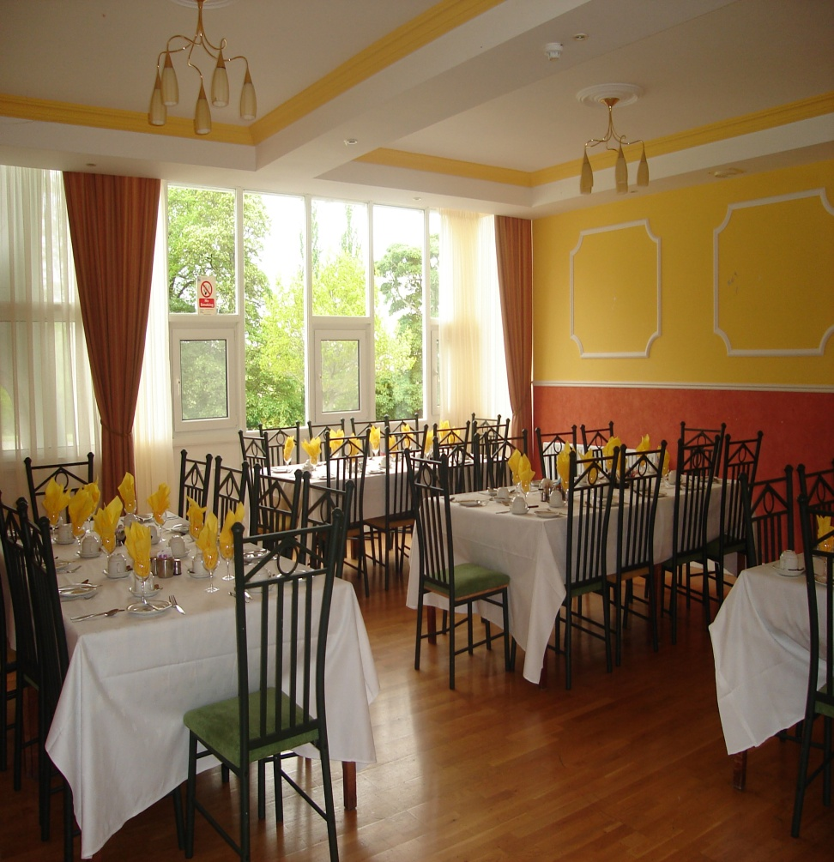
Large Dining Room

Slide 13
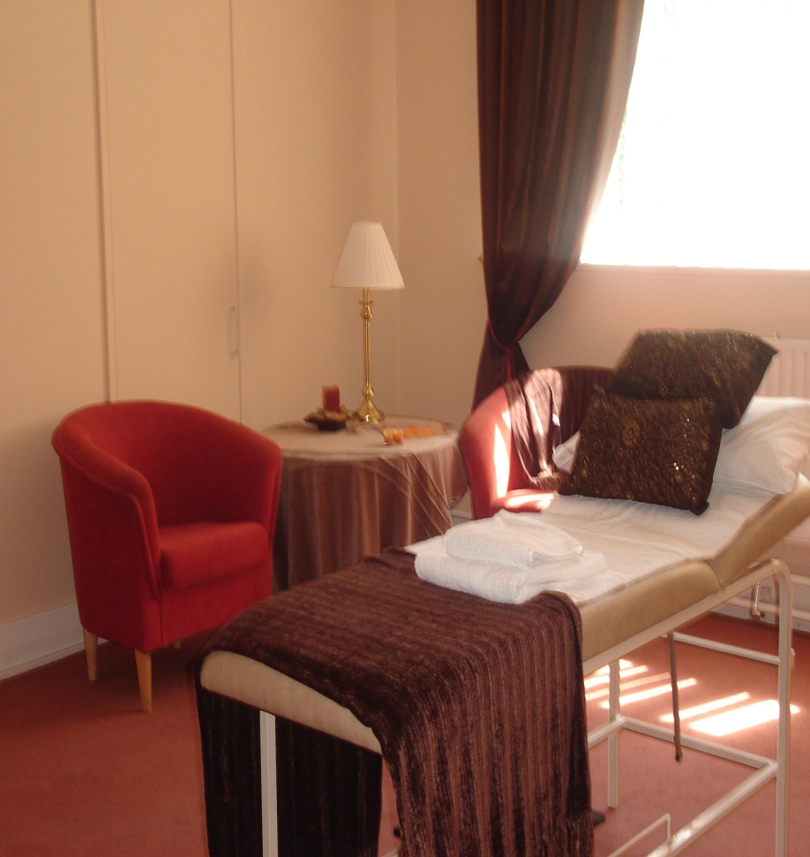
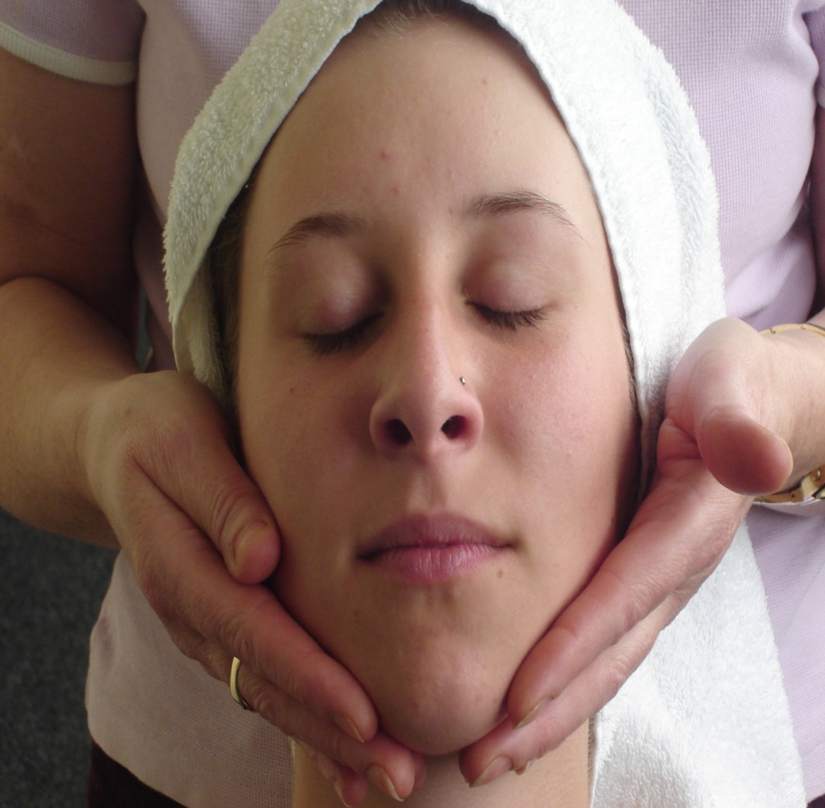
Castleview Therapy Suite

Slide 14
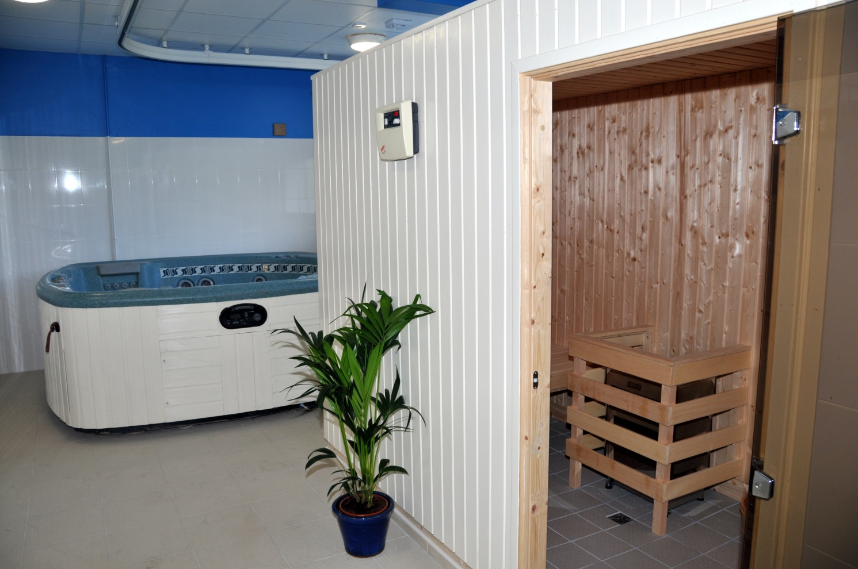
Leisure Suite

Slide 15
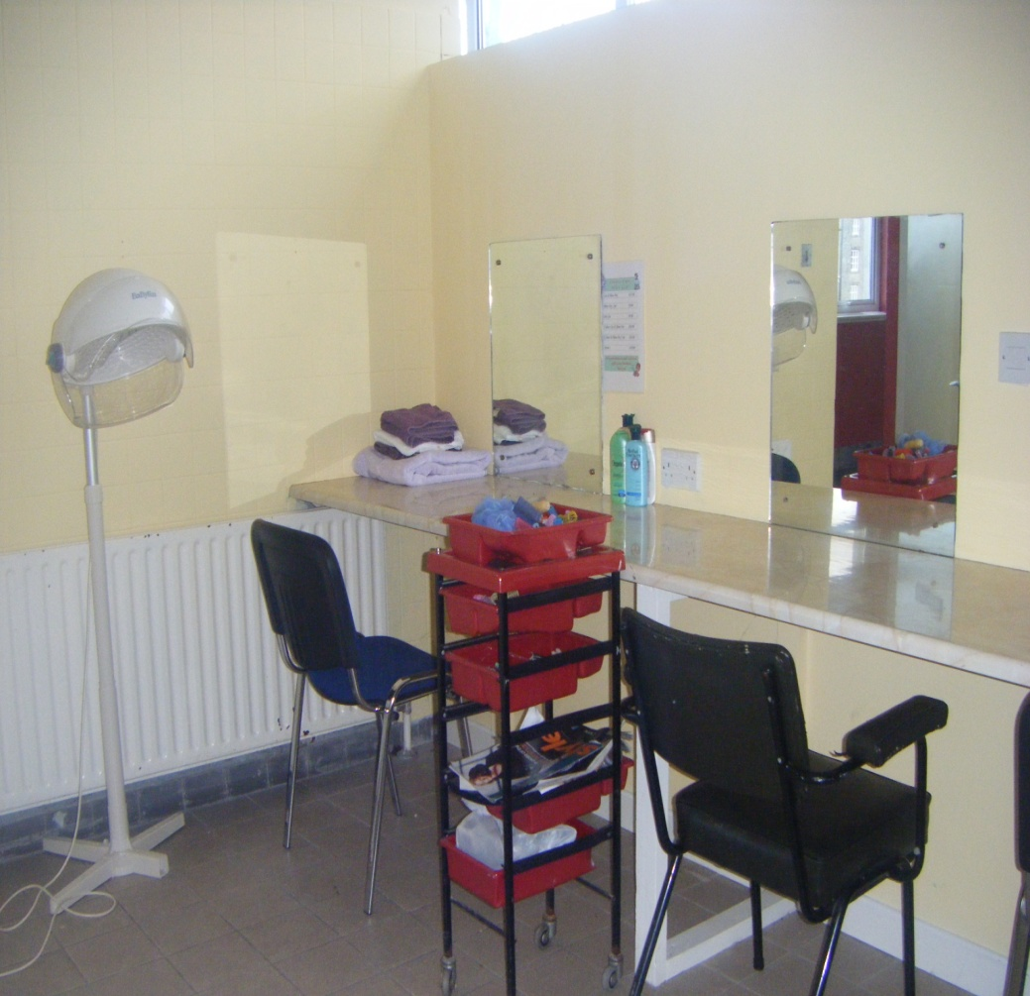
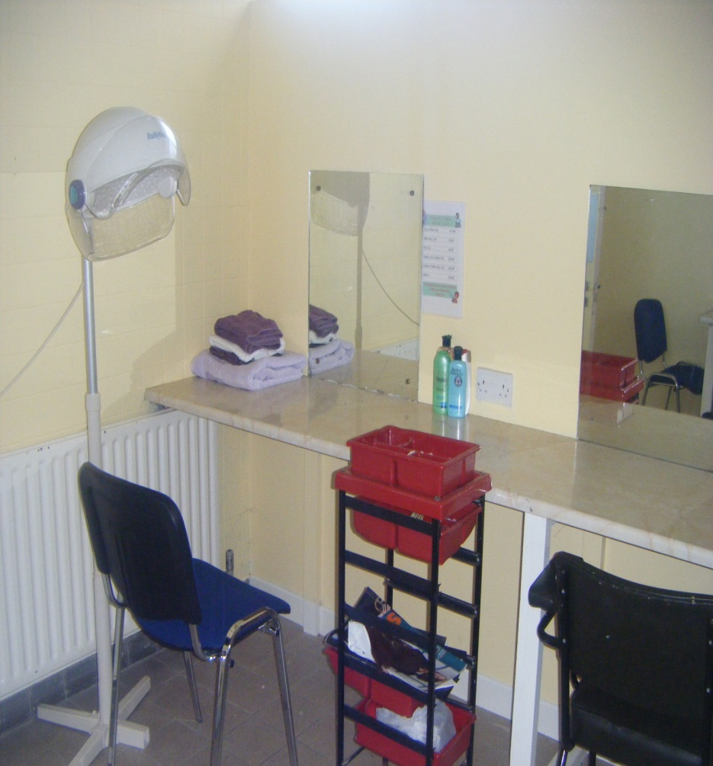
Hairdressing Salon

Slide 16
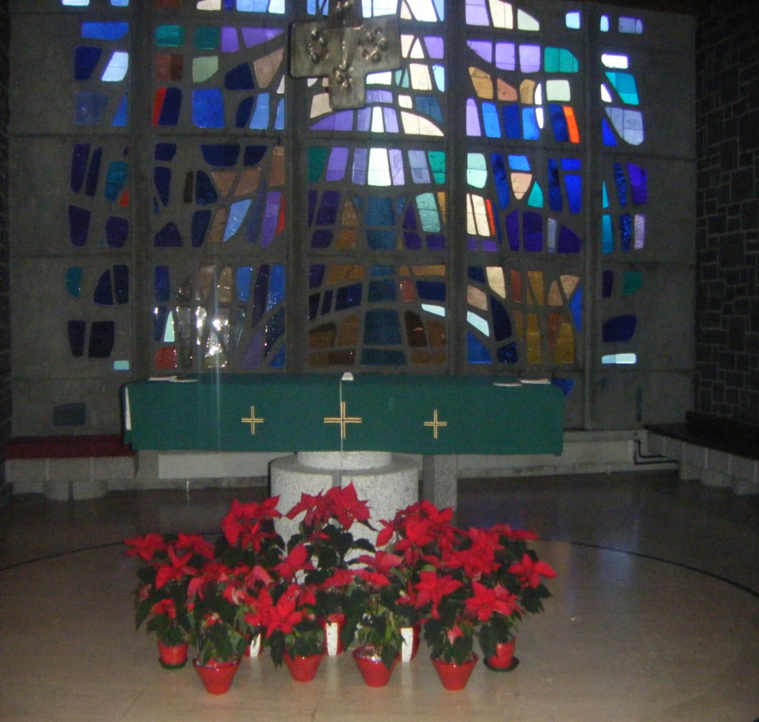
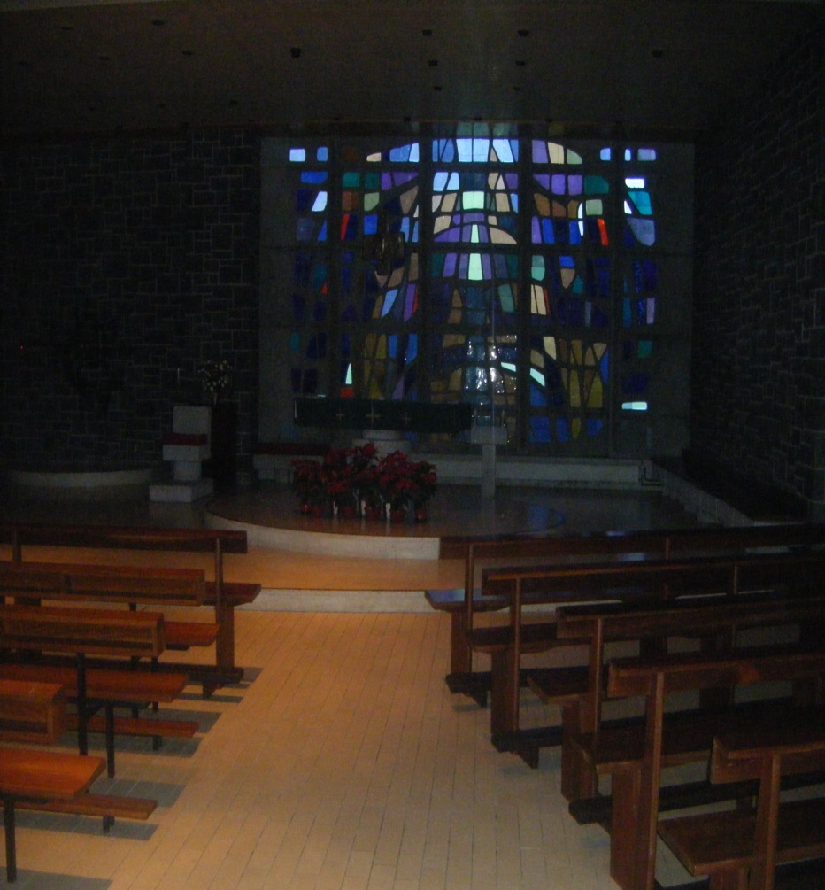
Church

Slide 17
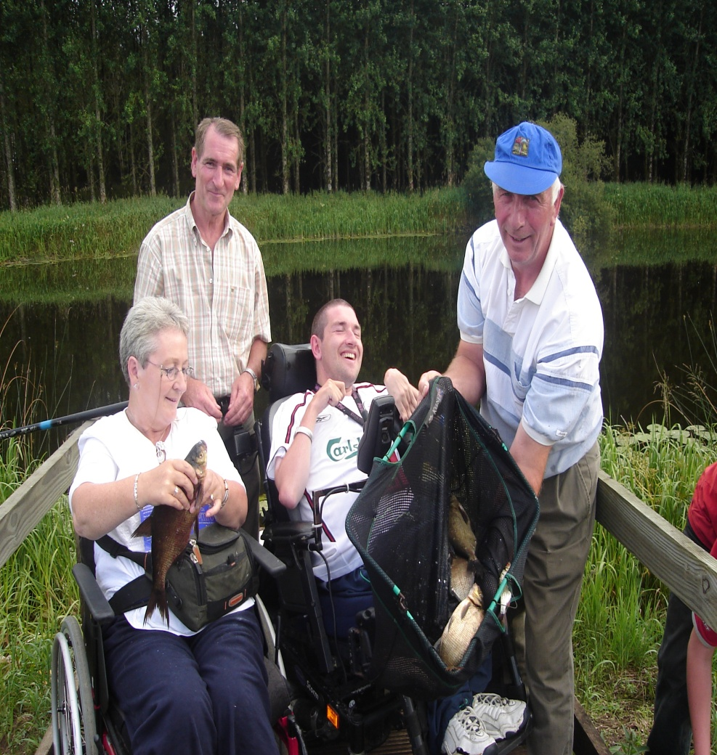
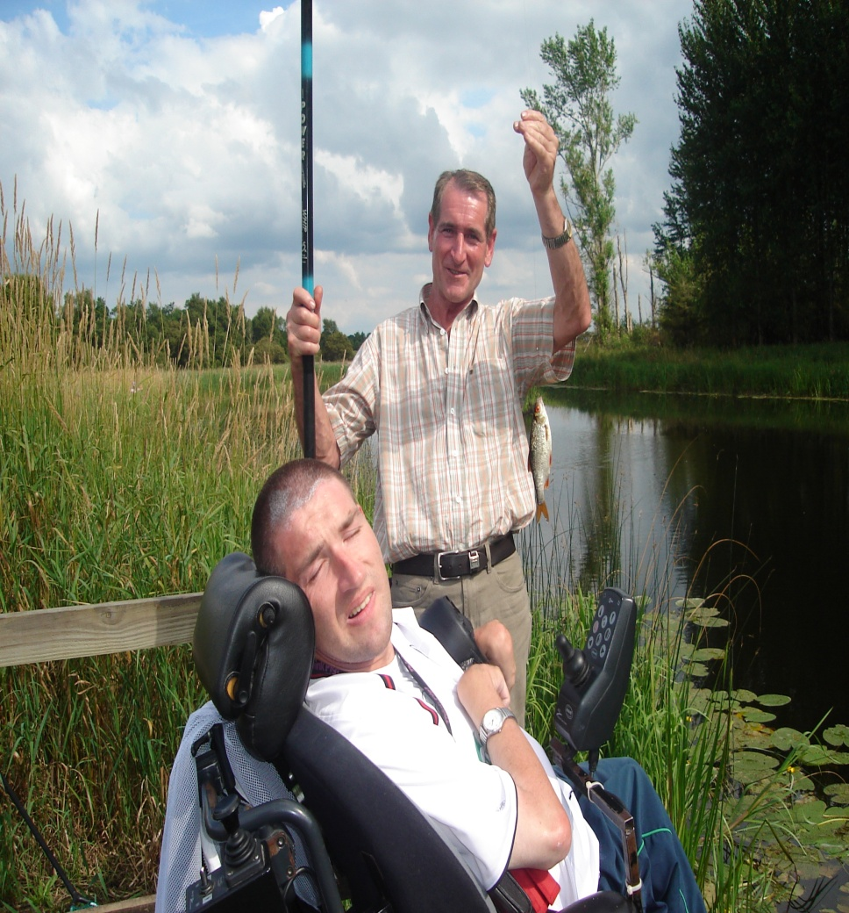
31 accessible Fishing bays

Slide 18
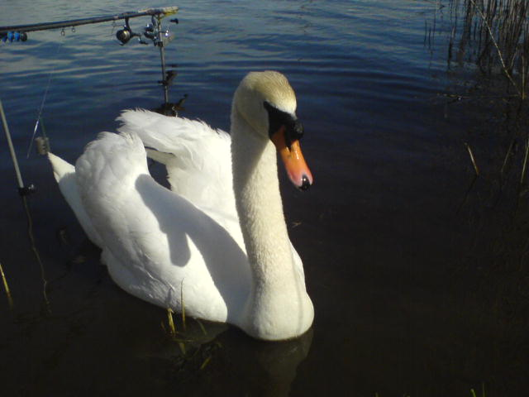
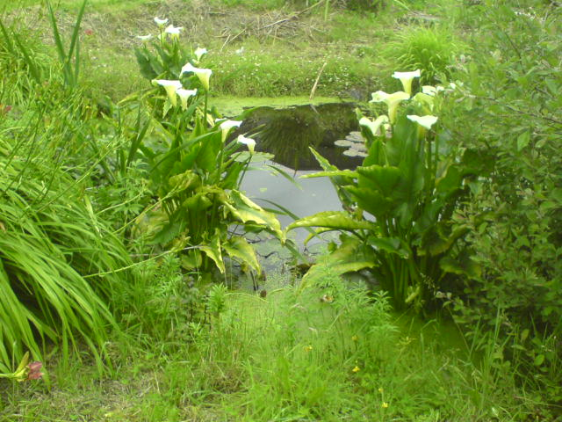

Slide 19
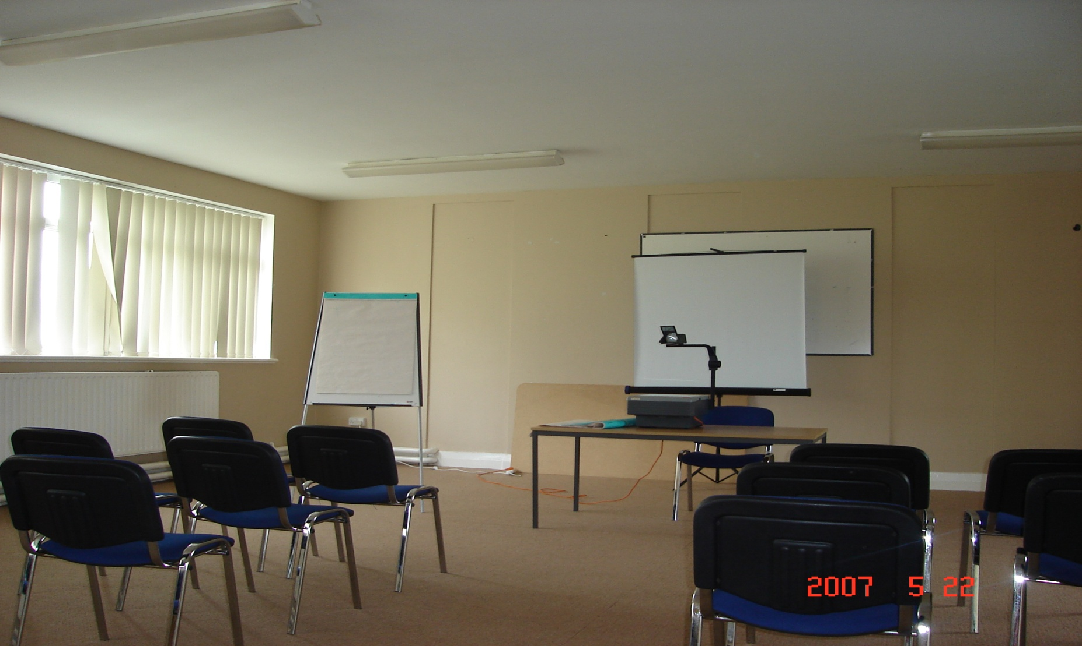
Conference Rooms

Slide 20
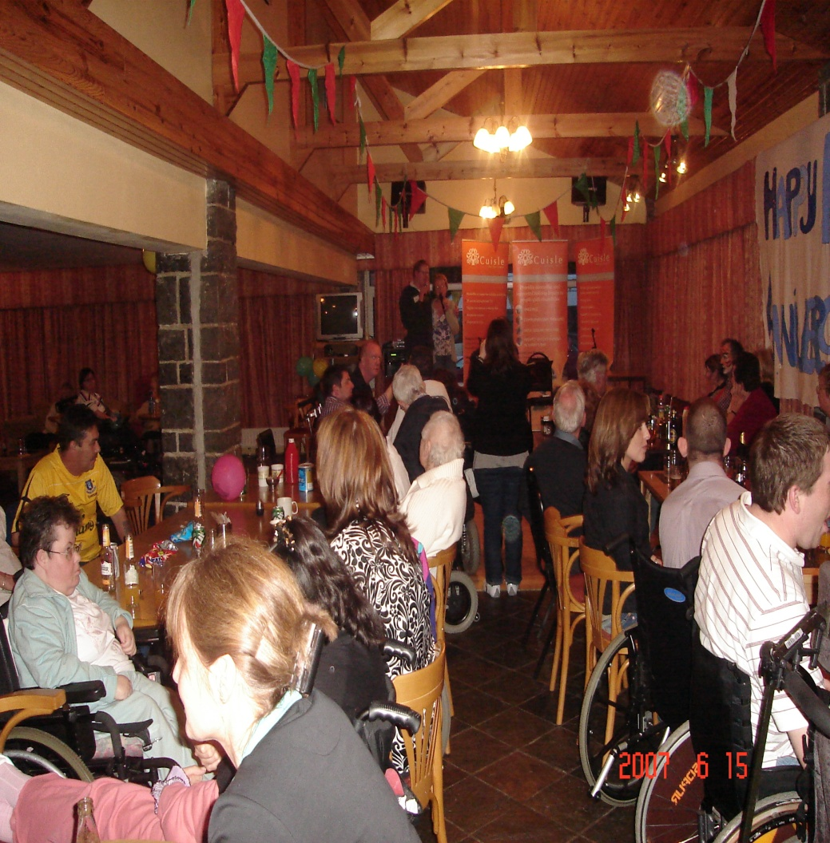
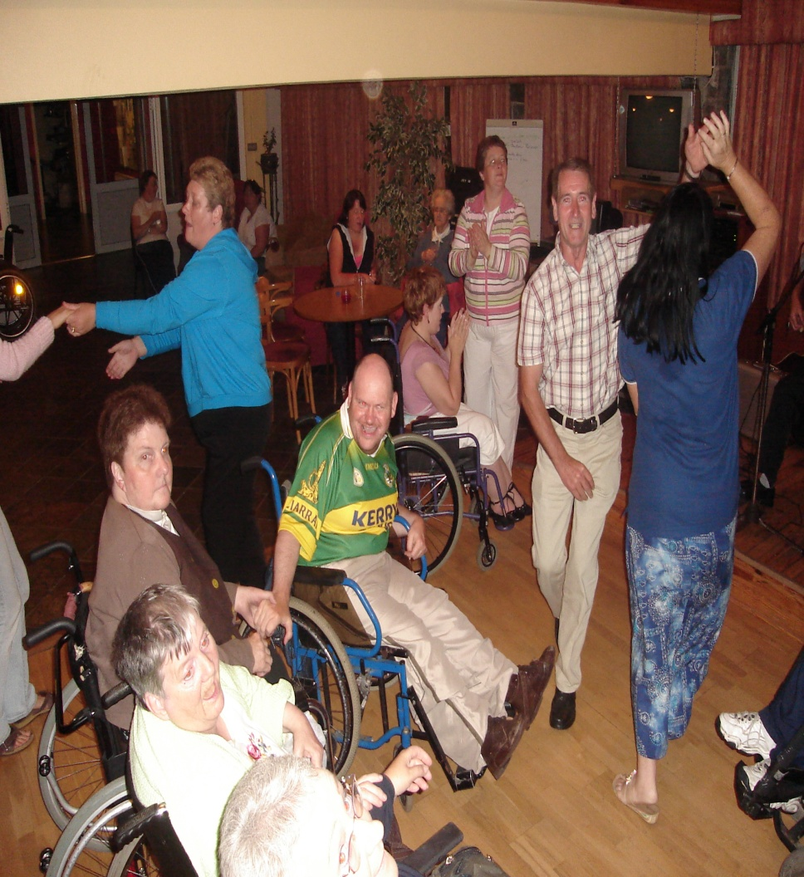
Nightly entertainment in
Harry’s Bar

Slide 21
Day Trips
  Shopping (Roscommon, Athlone, Galway)
  Cinema
  Bowling
  Knock
  Museums

Slide 22
Themed Breaks
  Body, mind and Spirit
  Easter
  Youth Holidays
  Fishing
  Holistic Therapies
  Family breaks
  Christmas
  St. Patrick’s weekend
  Valentine’s

Slide 23
I.W.A. Holiday Centres
Cuisle, Donamon, Co. Roscommon
70 beds. Telephone 090 6662277
Carmel Fallon Centre, Blackheath Drive
Clontarf, Dublin 3
6 Beds. 01 8186458
Claddagh Court, College Road, Kilkenny
4 Beds 056 7762775

Slide 24
Unique Holiday Centre
Open all year around, including Christmas and Easter
Fully accessible
En-suite bedrooms
Bar
Dining room
Nightly entertainment
Organised day trips

Slide 25
Comments
Here is what some of our guests say!!!
“It was the best Christmas of my life”
“It’s impossible to pick out just one member of staff, they are all exceptional”

Slide 26
More Comments
“I’m mad about the place. There are great things to do, great care, great food and staff are exceptionally kind”
“It’s a great place to make friends”
“Anytime I go there I have a great time, I can really relax in Cuisle”

Slide 27
Cuisle Holiday Centre,
Donamon, Co. Roscommon.
The perfect place for your holiday
Great Fun – Great Care
In a
Warm, Friendly Athmosphere

Slide 28
Enquires & Bookings
Telephone: 090 6662277
Email: cuisle@iwa.ie
Web: www.cuisle.com

Slide 29
Thank you
Any Comments.
Any Questions.

